Slide 1
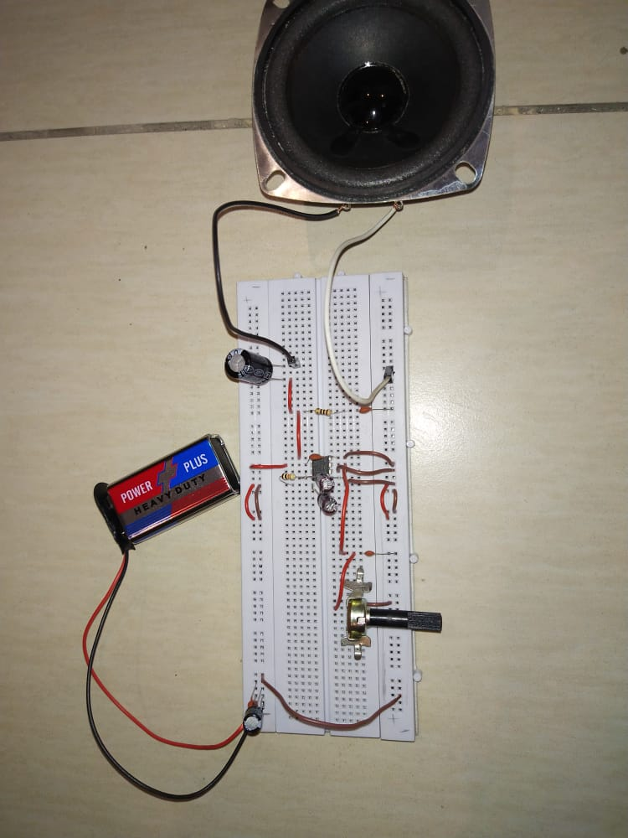
Audio or Music Amplifier
Members:
Iqra Asif 20k-0339
Mukand Krishna 20k-0409
Bahadur Khan 20k-1081

Slide 2
Introduction:
It is a low voltage power amplifier.
The heart of the amplifier is IC LM 386.
Input can be given through mobile or laptop.
Audio amplifiers are used for increasing the magnitude of power of a weaker audio Signal.

Slide 3
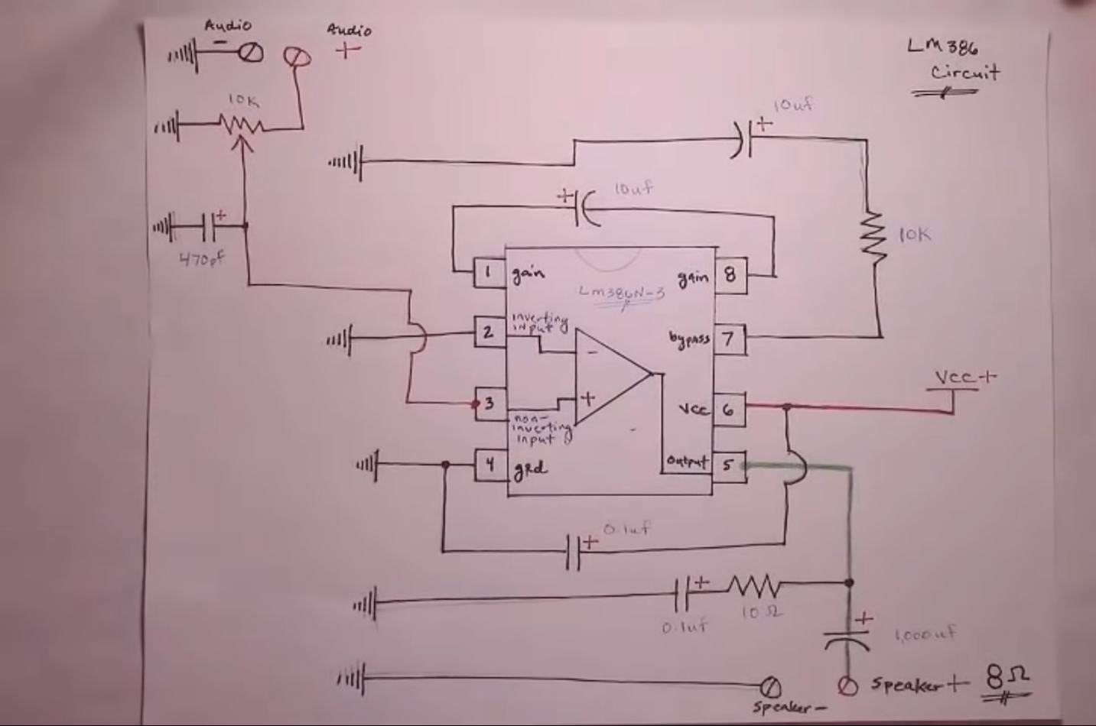
Circuit diagram

Slide 4
Components used
S.NO | Components | Qty.
1. | Power supply or Battery (5V to 15V DC) | 1
2. | 100uf capacitor (used for power supply decoupling) | 1
3. | Audio jack | 1
4. | LM386 N-3 | 1
5. | 220 to 1000uf capacitor (between amp output and speaker) | 1
6. | 470pf capacitor (used to reduce RF interference) | 1
7. | 10uf capacitors (x2) (gain and bypass) | 2
8. | 0.1uf capacitors (x3) polyester tends to sound better than ceramic | 3
9. | 10 Ohm resistor | 1
10. | 10k Potentiometer | 1
11. | 8 Ohm speaker (1 watt minimum) | 1
12. | Jumper wires | 1
13. | Breadboard | 1

Slide 5
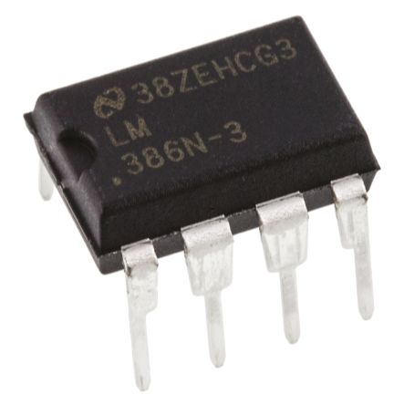
IC LM386
It is a lower power audio amplifier audio integrated circuit
It is an 8 pin IC in which 7 pins are used.
Operates on 9 volt.
Supply is given to pin Number 6.
4th pin is connected to ground.

Slide 6
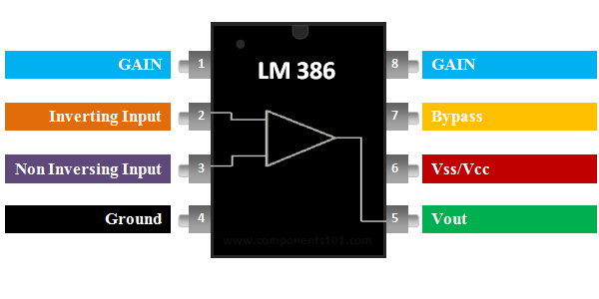
Pin configuration

Slide 7
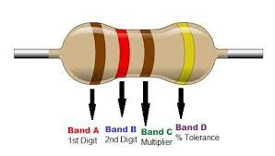
Resistors
There are many types of resistors, both fixed and variable. The most common types for electronics use is carbon resistor. They are in different physical sizes.
The resistor value and tolerance
determined from resistor color code.

Slide 8
1. LM-386 IC is put in the breadboard. Battery of 9V is used. 100 microfarad capacitor and 0.1 microfarad capacitor are added to decoupling the power. To adjust resistance between two terminals. 2. Potentiometer is added. 3. 470 picofarad capacitor is used from center pin of potentiometer and grounded. 10 microfarad capacitor is connected between 1st and 8th pin of LM-386 IC. 4. Pin 7 which is bypass pin from which 10k resistor is connected to 10 microfarad capacitor and grounded.
Working

Slide 9
5. 0.1 microfarad capacitor is used to connect the 4th pin and goes to grounded rail and 6th pin goes to VCC rail. 6. 470 picofarad capacitor connected to pin 3. 7. Pin 5 which is connected to 10ohm resistor and is connected to positive terminal of 0.1 microfarad capacitor then grounded. 1000 microfarad capacitor: its negative terminal is connected to positive terminal of the speaker. The negative wire of speaker is grounded.
Working continue…

Slide 10
It is used in: 1. AM and FM radio amplifiers 2. Portable music players 3. TV sound system 4. Line drivers and many more.
Applications

Slide 11
Thank you

